Slide 1
Seminar about Linearized Hydrodynamic Equations
Jiacheng Huang
20210425

Slide 2
Outlines
Why?
How to Do?
Transverse & Longitudinal Hydrodynamic Modes

Slide 3
Why?

Slide 4
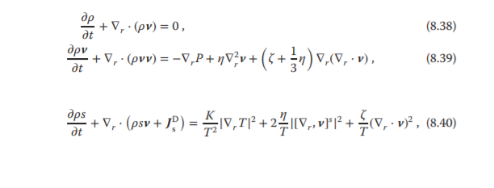
NS Equation

Slide 5
NS Equation
1> Solving the situation that depend nonlinearly on the thermodynamic variables and the average velocity
2> Decouple Transverse & Longitudinal Hydrodynamic Modes
3> A good model to analysis _ ? Long-time tails e tal
Dib R , Ould-Kaddour F , Levesque D . Long time behaviour of the velocity autocorrelation function at low density and near critical point of simple fluids. 2006.

Slide 6
How to Do?

Slide 7
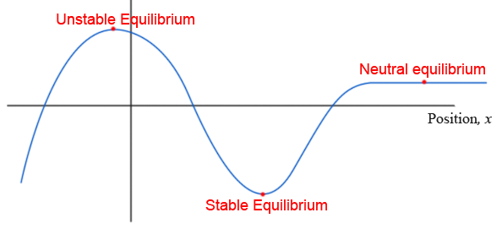
Def
The linearized hydrodynamic equations describe the behavior of the fluid if it is only slightly displaced from absolute equilibrium

Slide 8
Def
The linearized hydrodynamic equations describe the behavior of the fluid if it is only slightly displaced from absolute equilibrium

Slide 9

Set the point
Density:
Temp:
Entropy:
Pressure:
Velocity:

Slide 10
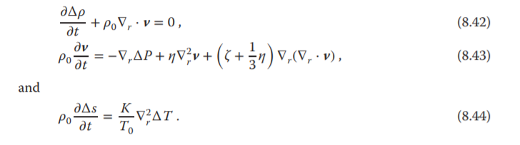
Substitute
we substitute these expansions into
the hydrodynamic equations (8.38)–(8.40), and only retain terms to first order in deviations from equilibrium

Slide 11
Reducing Dimensions
Density:
Temp:
Entropy:
Pressure:
Velocity:
X3
five equations but we have seven unknowns

Slide 12
Reducing Dimensions
c
Density:
Temp:
Thermodynamic Related
Entropy:
Pressure:
Velocity:
X3
five equations but we have seven unknowns

Slide 13
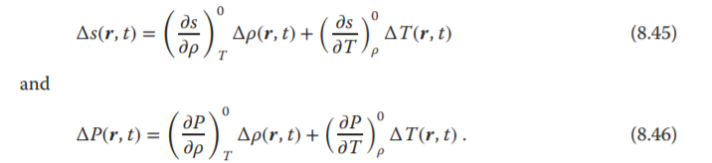
Reducing Dimensions
Reducing dimensions by thermodynamic equations

Slide 14
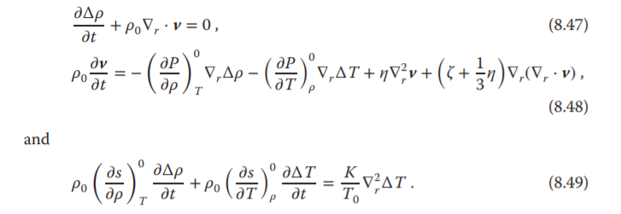
Substitute

Slide 15
Substitute
c
c

Slide 16
Substitute
Linearized Hydrodynamic Equations

Slide 17
Transverse & Longitudinal
Hydrodynamic Modes

Slide 18
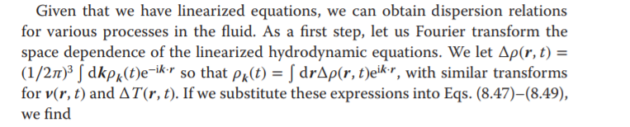
Dispersion Relations

Slide 19
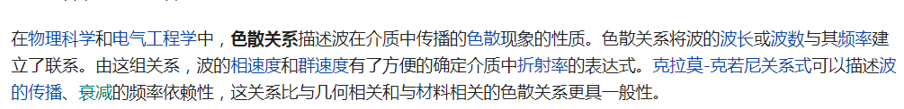
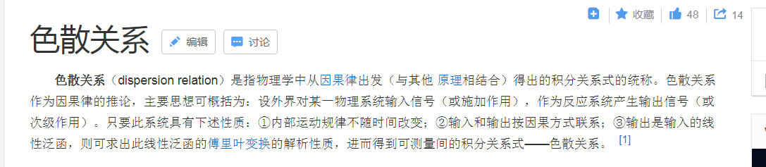
Dispersion Relations
https://en.wikipedia.org/wiki/Dispersion_relation https://baike.baidu.com/item/%E8%89%B2%E6%95%A3%E5%85%B3%E7%B3%BB

Slide 20
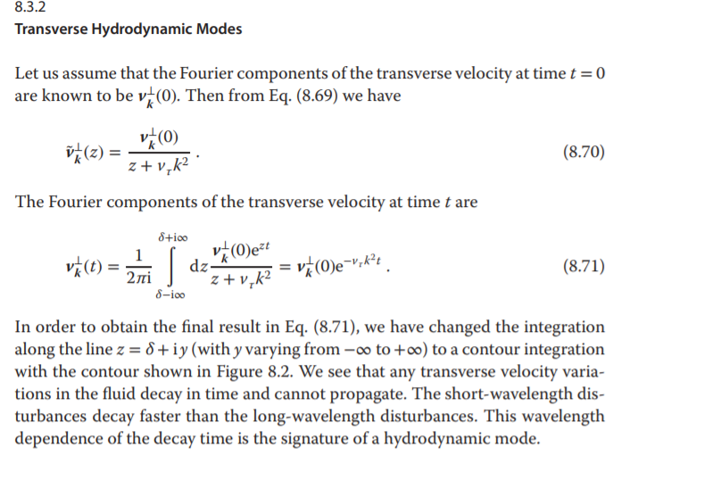
Dispersion Relations

Slide 21
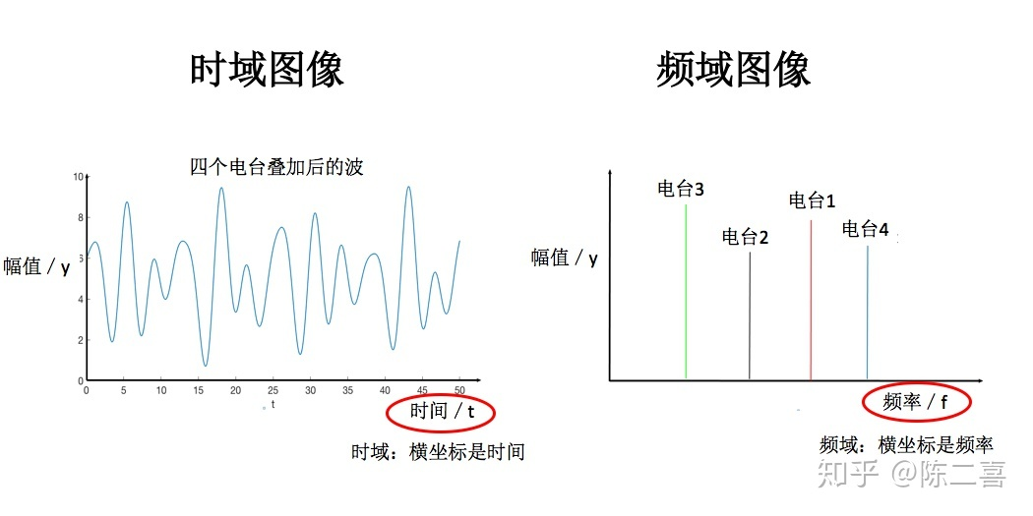
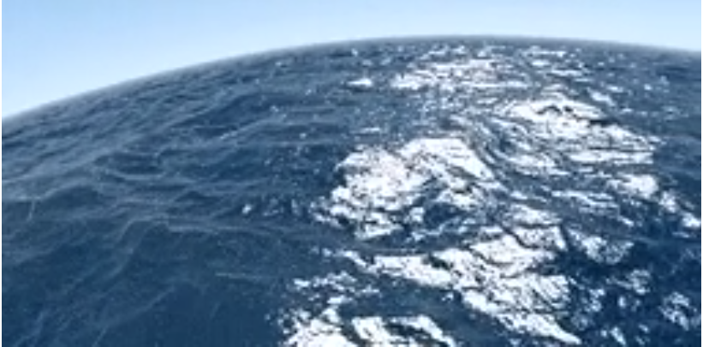
Dispersion Relations
https://www.zhihu.com/question/19714540

Slide 22
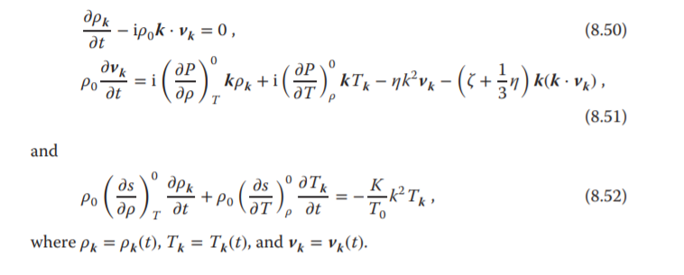
Substitute

Slide 23

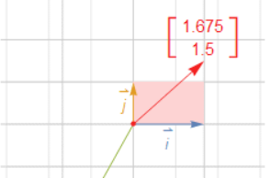
Decouple
Let us divide the velocity into
longitudinal (parallel to k) and transverse (perpendicular to k) components

Slide 24

Decouple
Let us divide the velocity into
longitudinal (parallel to k) and transverse (perpendicular to k) components
Some Property

Slide 25
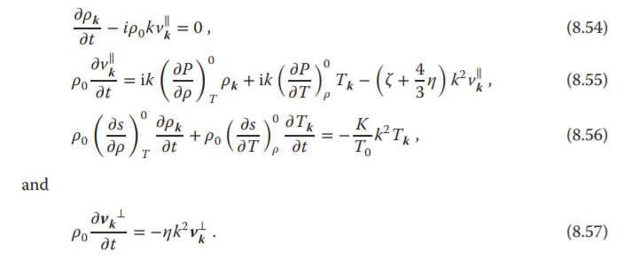
Substitute

Slide 26
Substitute
Decouple！

Slide 27
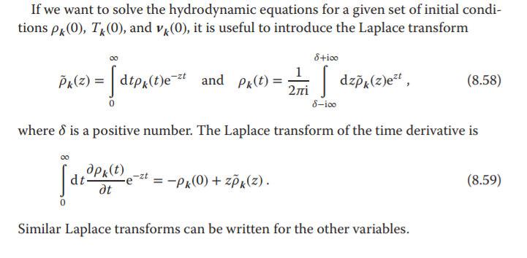
Solving the Equation by Laplace Transforms

Slide 28
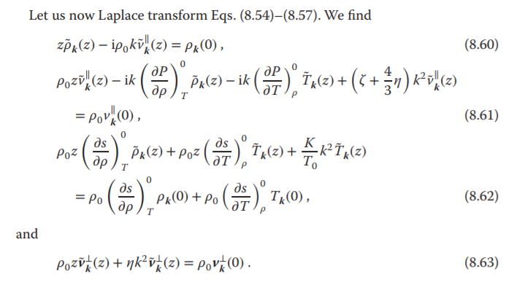
Solving the Equation by Laplace Transforms

Slide 29
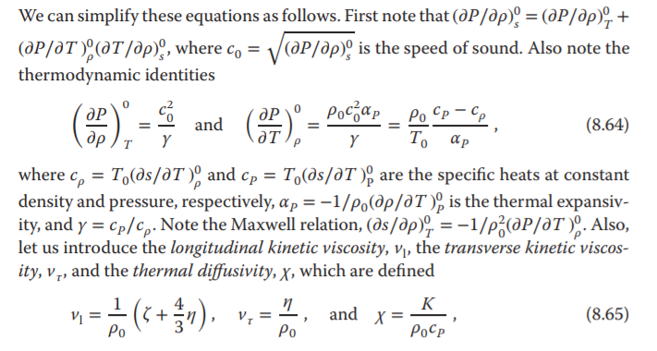
Simplify More

Slide 30
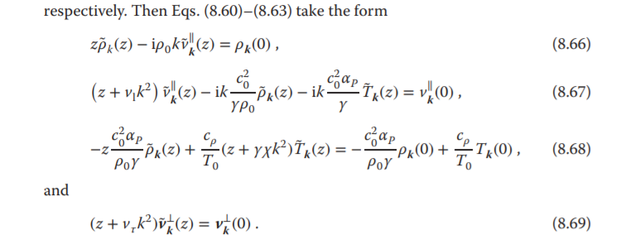
Simplify More

Slide 31
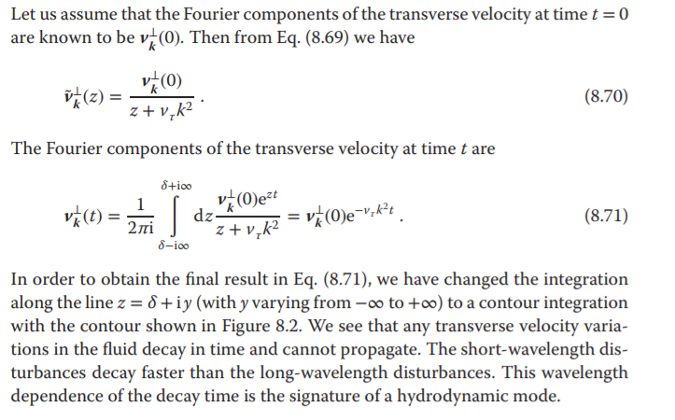
Analysis
Transverse

Slide 32
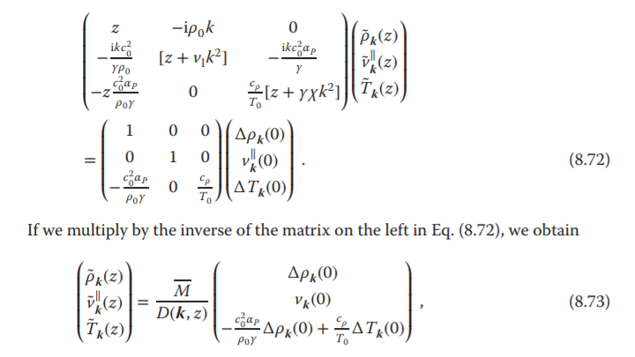
Analysis
Longitudinal
The time evolution of the longitudinal modes can be determined from Eqs. (8.66)–
(8.68). Let us first write them in the following matrix from

Slide 33
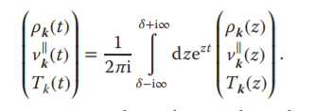
Analysis
Longitudinal
Then Reverse Transform

Slide 34
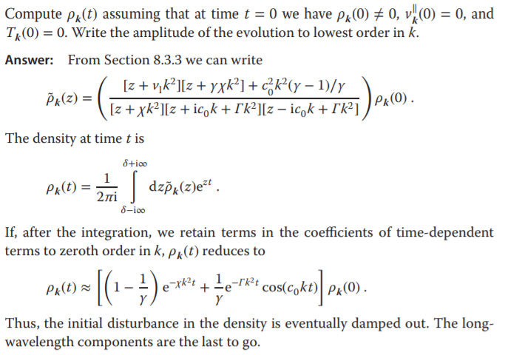
Analysis
Longitudinal
Then Reverse Transform

Slide 35
References
[1] A Modern Course in Statistical Physics, 4. Edition. Linda E. Reichl.
[2] A Modern Course in Statistical Physics, 2. Edition. Linda E. Reichl.
[3] Dib R , Ould-Kaddour F , Levesque D . Long time behaviour of the velocity autocorrelation function at low density and near critical point of simple fluids. 2006.
[4] https://en.wikipedia.org/wiki/Dispersion_relation
[5] https://baike.baidu.com/item/%E8%89%B2%E6%95%A3%E5%85%B3%E7%B3%BB
[6] https://www.zhihu.com/question/19714540

Slide 36
Thank You

